Slide 1

Team Name : LUNAlytics
Team Leader Name : Nerusu Nutana Sai Niveditha
Problem Statement : Novel method to detect landslides & boulders on the Moon: Using Chandrayaan images

Slide 2

Team Members
Team Leader: Name: Nerusu Nutana Sai Niveditha College: KL University | Team Member-1: Name:Jarajapu Indra Neel College: KL University
Team Member-2: Name: Madira Devendra Sainadh Reddy College: KL University

Slide 3
.
Brief about the idea:
A novel AI-based technique using high-res lunar images.
Automatically detect boulder trails and slope failures.
USP: Use of indigenous satellite imagery and deep learning

Slide 4
Opportunity should be able to explain the following:
Uses Chandrayaan-2&3 OHRC and TMC data.
Focus on AI-driven segmentation and classification.
Prioritizes mission safety and rover path optimization.

Slide 5
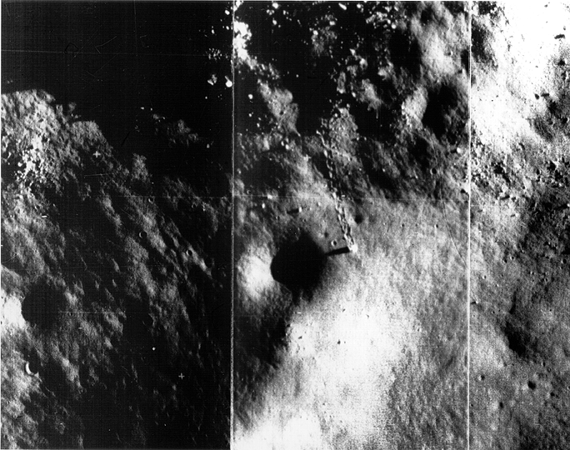
List of features offered by the solution
1. Boulder trail and landslide detection

Slide 6
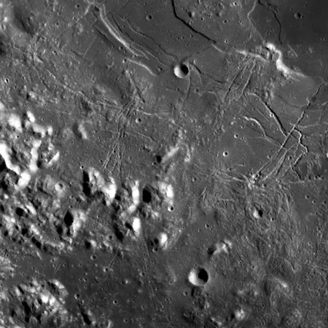
List of features offered by the solution
2. Slope analysis using DEM overlays.

Slide 7
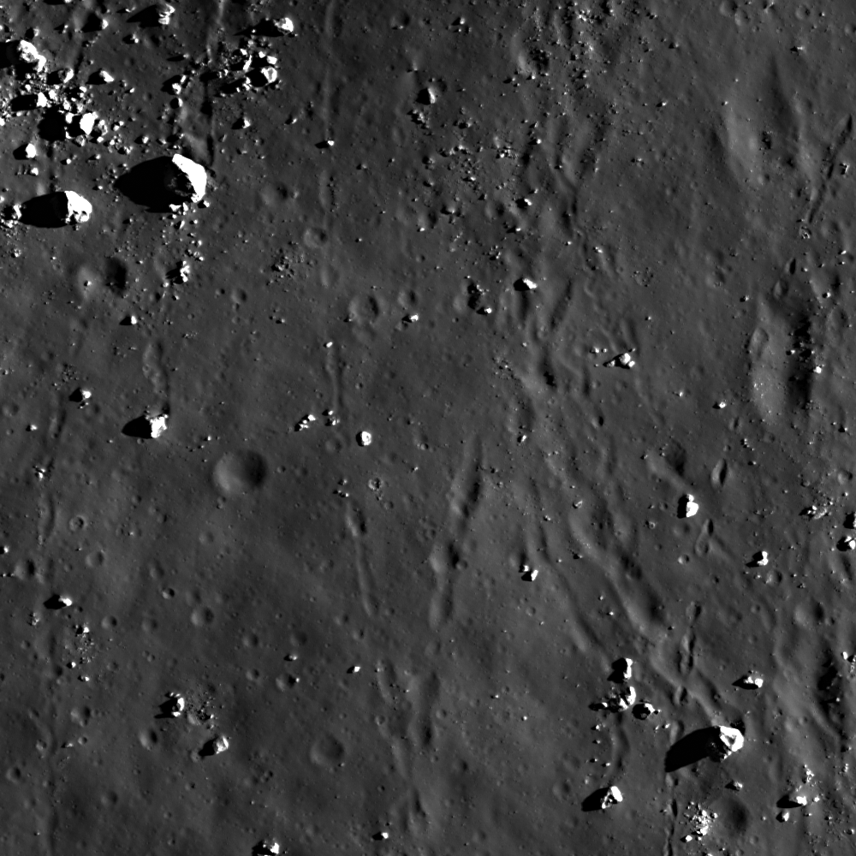
List of features offered by the solution
3.Output visualized as a lunar hazard map.

Slide 8
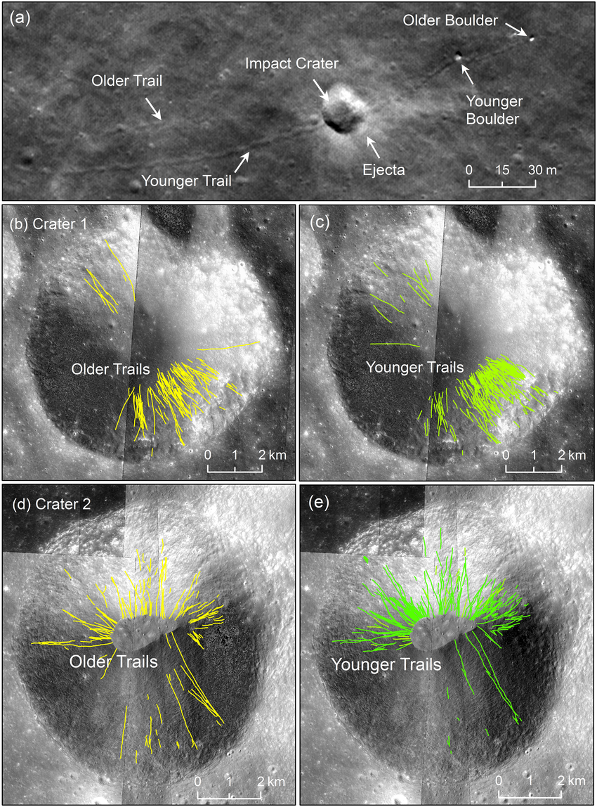
List of features offered by the solution
4.Real-time image processing for future rover cams.

Slide 9

Use-case diagram

Slide 10
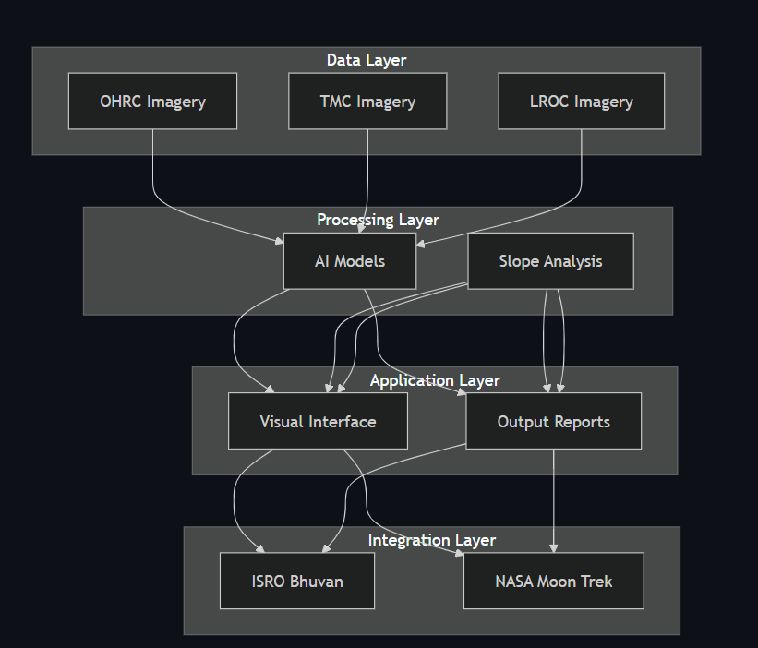
Architecture diagram of the proposed solution

Slide 11
Technologies to be used in the solution:
Python, OpenCV, TensorFlow: Python is the main language; OpenCV preprocesses and analyzes lunar images; TensorFlow is used for deep learning model training and inference.
YOLOv8, U-Net: YOLOv8 detects objects like boulders and landslides; U-Net segments features such as cracks and unstable zones.
GIS tools (QGIS/ArcGIS): Visualize and analyze detection results on lunar maps, annotate features, and overlay risk zones.
Image data (Chandrayaan OHRC): High-resolution lunar surface images serve as the main data source for training and testing.
3D Analysis (DEM + Slope gradient modeling): Digital Elevation Models and slope calculations help assess terrain stability and identify hazard-prone areas.

Slide 12
